Slide 1
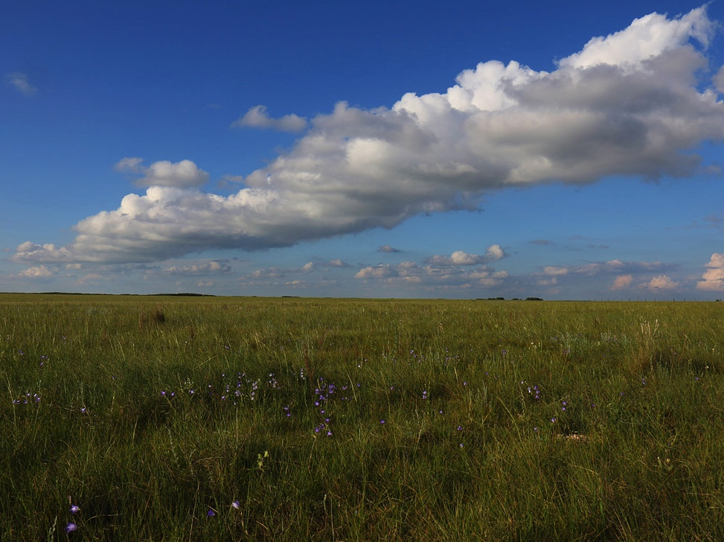
Roadmap to here
Photos & presentation: Dr. Christian Artuso
Canadian Wildlife Service
Notes:
Subtle beauty needs appreciation

Slide 2
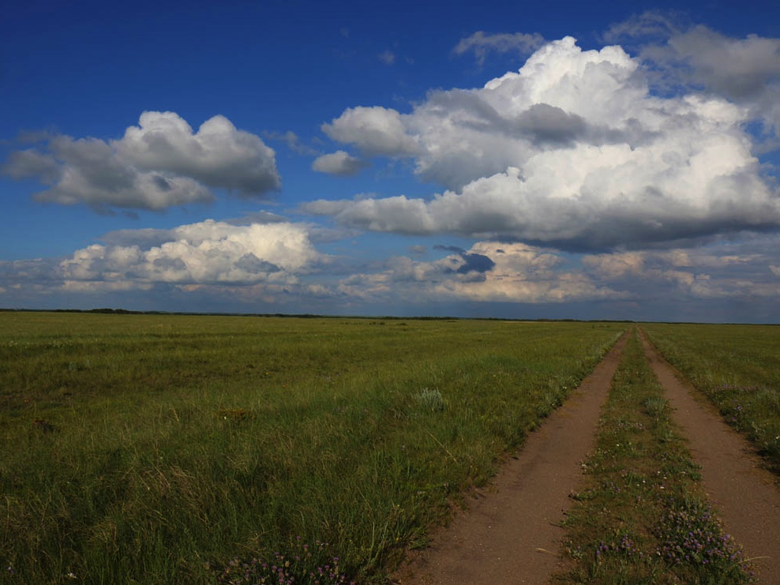

Slide 3
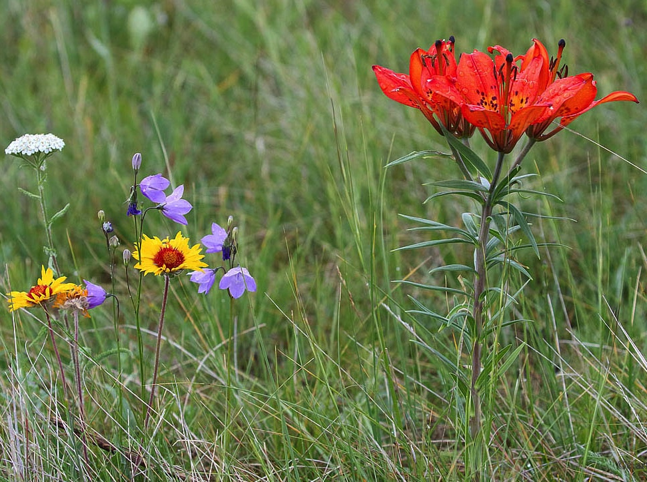

Slide 4
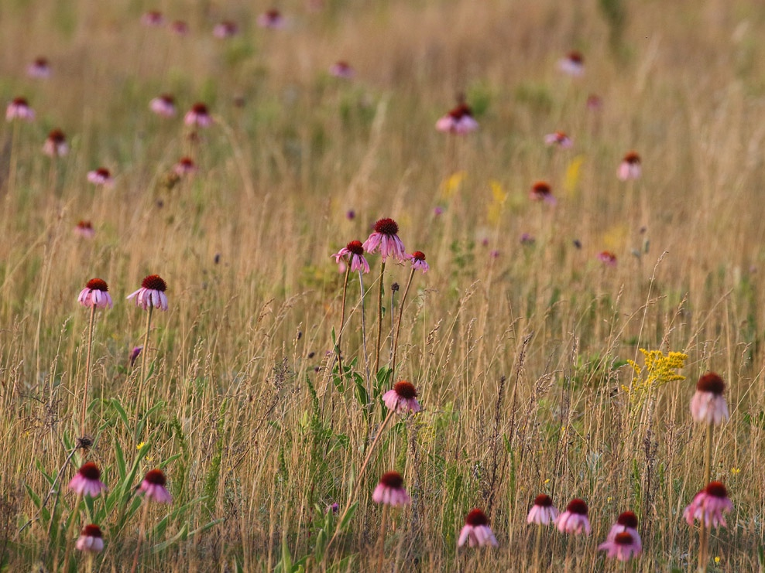

Slide 5
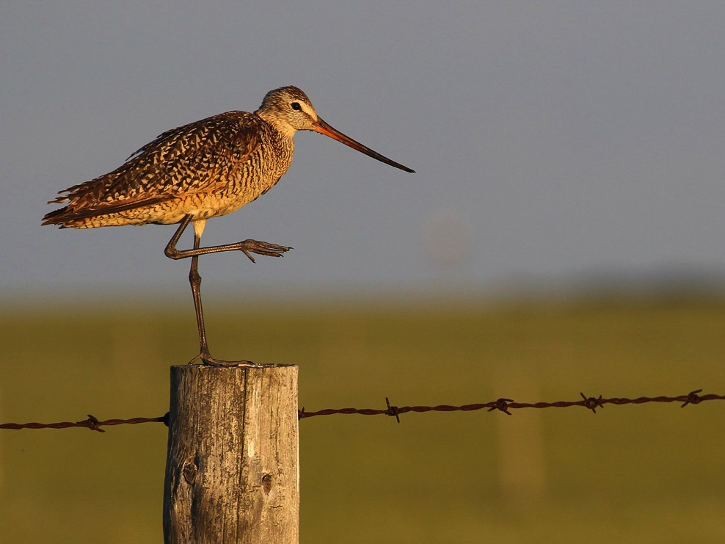

Slide 6
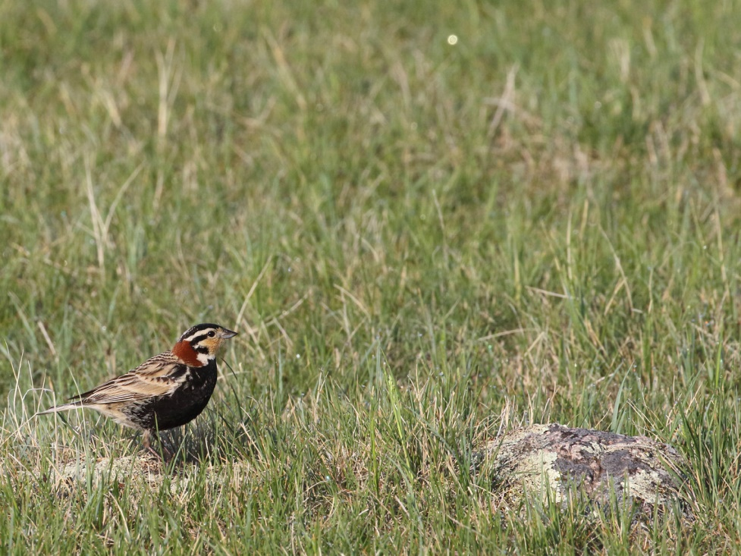

Slide 7
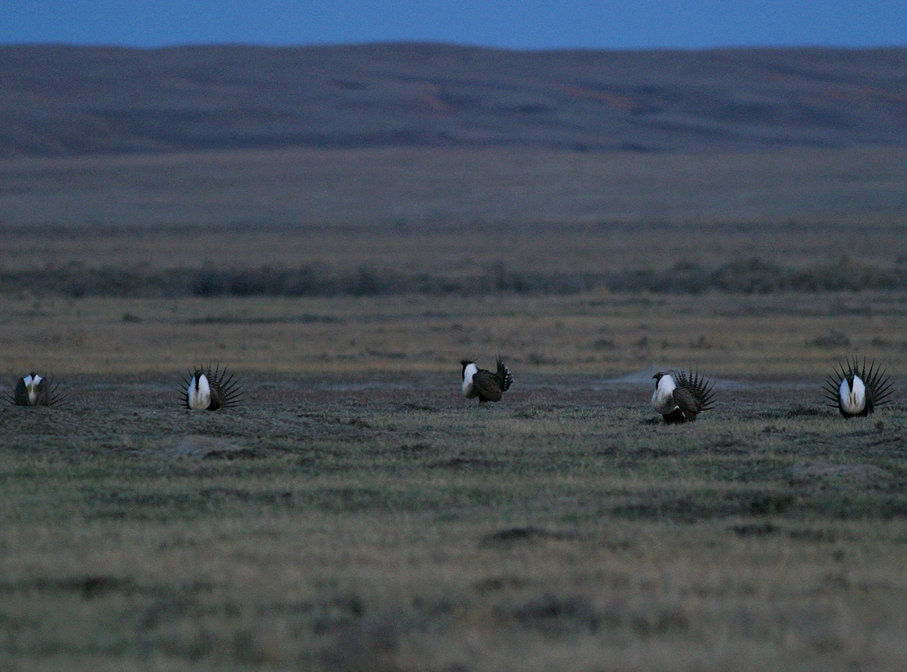

Slide 8
Notes:
Fences, crops, partitioned landscape LOSS: approximately 75% of native grasslands on the Canadian prairies have been lost to cultivation
Dry and wet cycles may be affected human–induced climate change (periodicity, spatial patterns of occurrence). Historically, prairie birds found suitable breeding conditions by movements within greater prairie ecosystem (now, options reduced!) Manitoba habitat fragments may become increasingly too wet for breeding (?) especially for shorter grass species such as CCLO

Slide 9
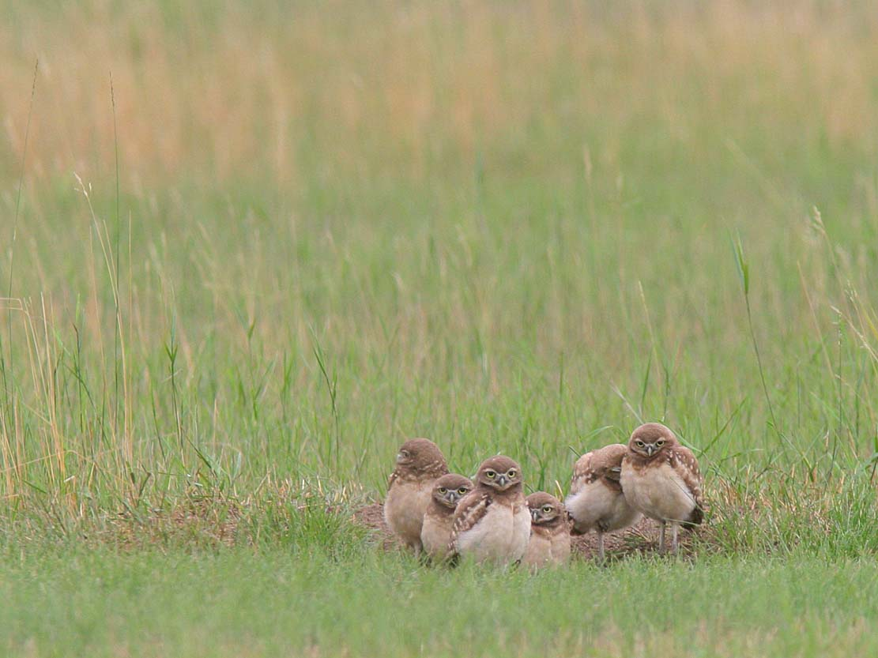

Slide 10
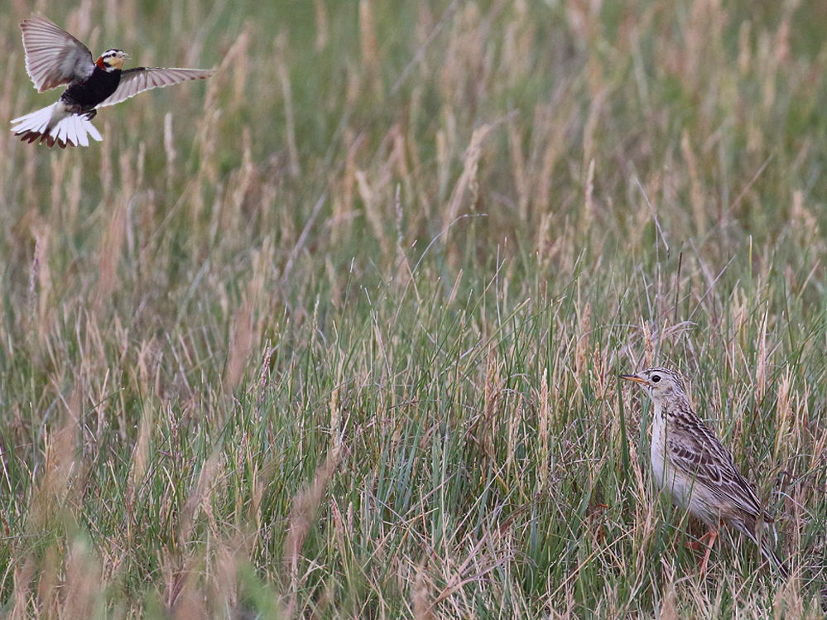
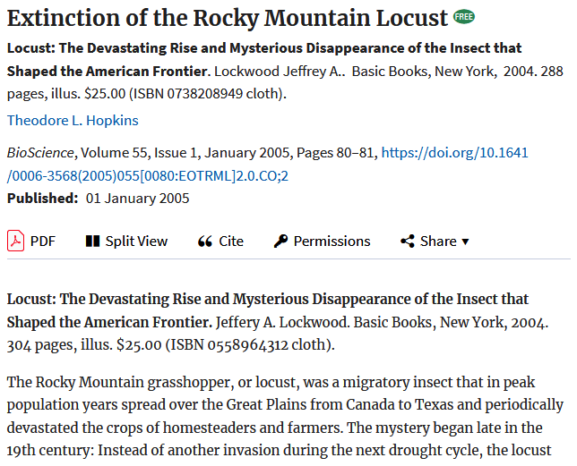

Slide 11
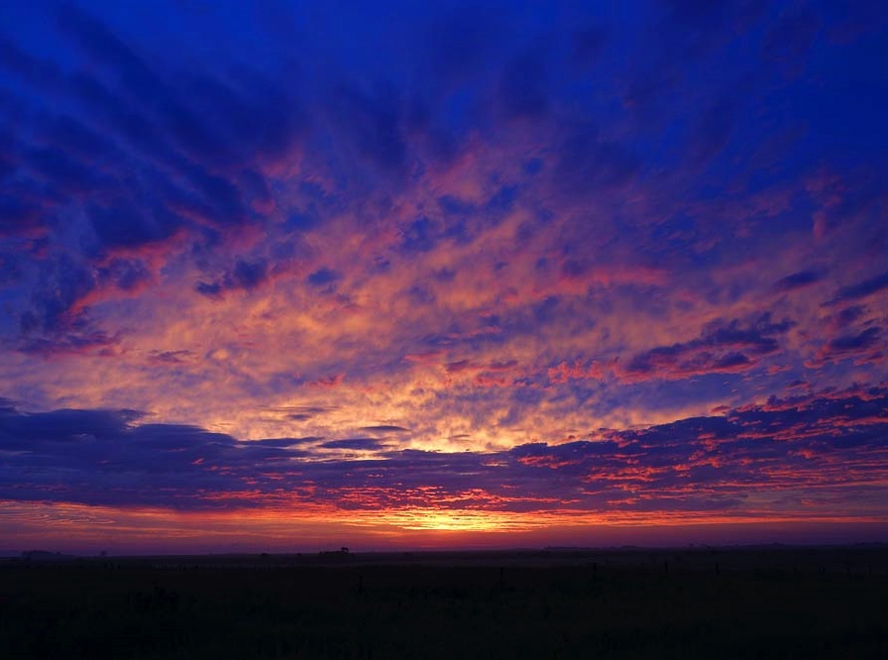

Slide 12
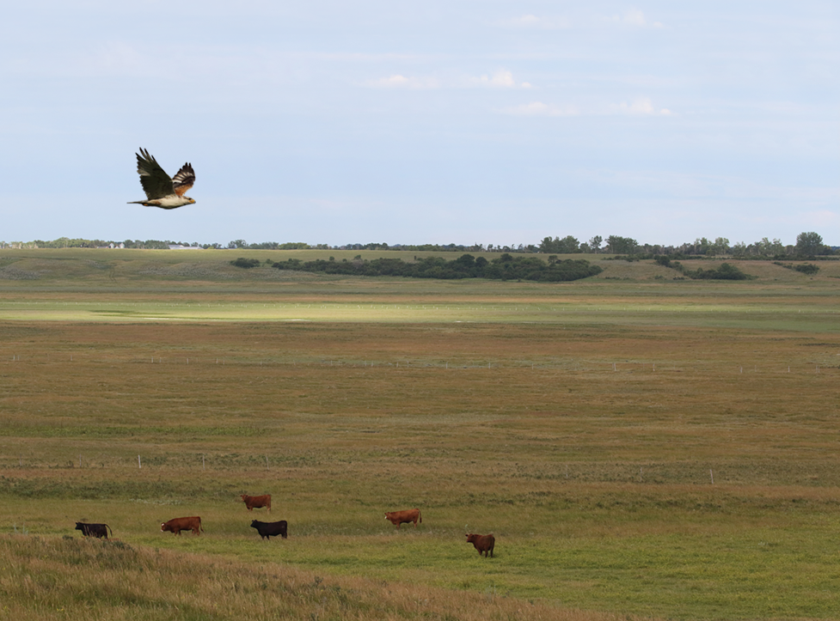
Thank you!

